Slide 1
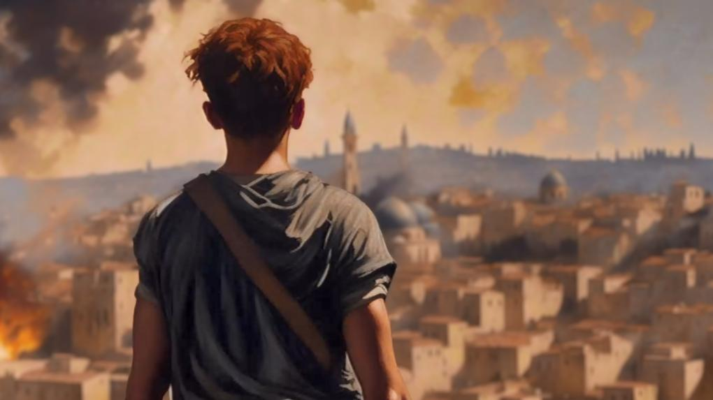

THE HEROISM OF OCTOBER 7th
A MICROCOSM OF JEWISH HEROISM OF ALL TIME
THE HEROISM OF OCTOBER 7th

Slide 2
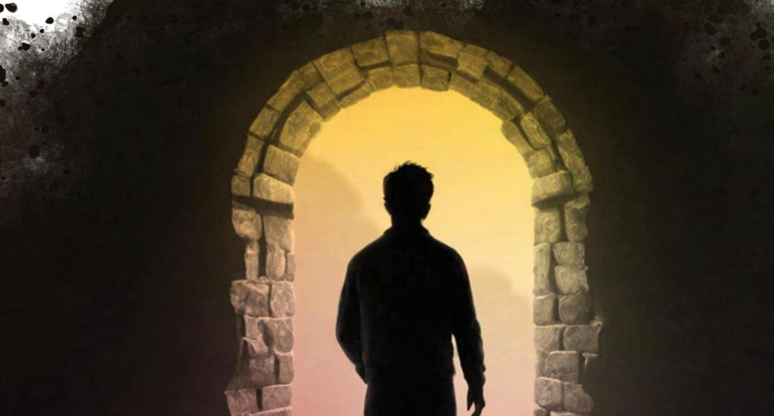
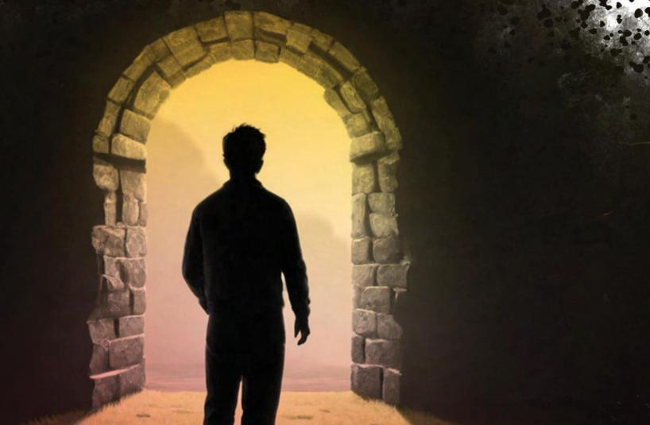
7.10
THE DARKEST DAY, BUT ALSO A DAY OF EXTRAORDINARY HEROISM
An exceptional number and rare quality of acts of heroism
Heroism rooted in the profound values of the Jewish people in times of crisis
From Abraham the forefather to this very day, the spirit of Jewish heroism continues to live.
THE HEROISM OF OCTOBER 7th

Slide 3





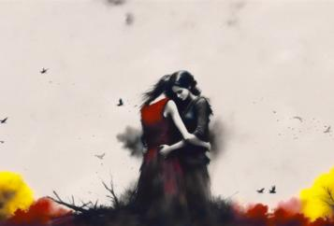
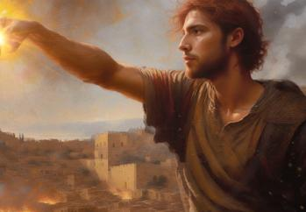
THE PROJECT HEROES' INITIATIVE
From within the trauma emerged a unique light of heroism
Together with the families of the heroes, a musical-visual program was created to tell the stories of the heroes of 7/10
Stories of ordinary people who performed extraordinary acts
It has grown into a global project: dedicated to shifting the Jewish narrative from victimhood to heroism
THE HEROISM OF OCTOBER 7th

Slide 4

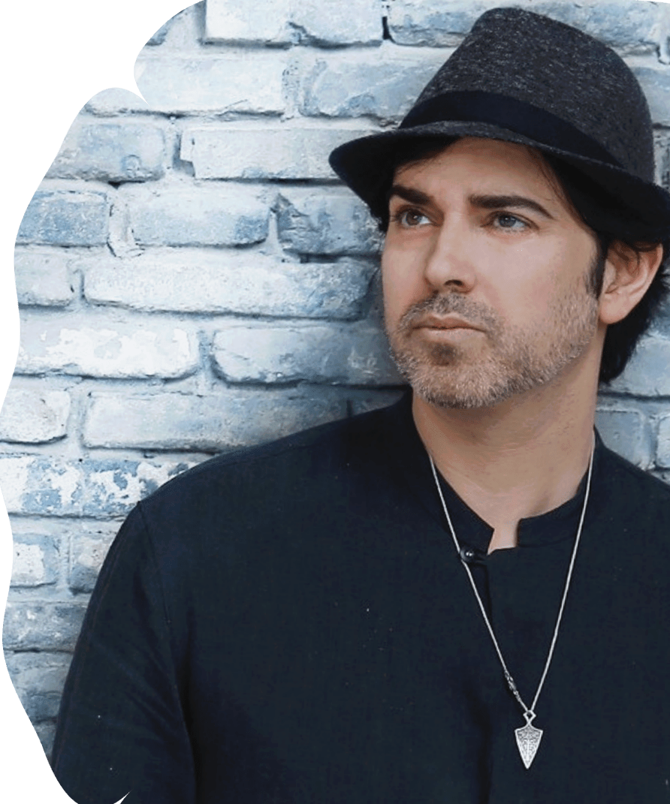


THE CREATOR OF PROJECT HEROES
Gilad Segev, an artist and social entrepreneur with international experience in creating innovative content experiences.
In the aftermath of October 7th,
came the revelation of a unique light of heroism - an understanding that the light of heroism is universal and must be shared with all humanity.
The program has been showcased on renowned stages worldwide and has grown into a major international educational initiative, dedicated to shifting the Jewish narrative from victimhood to heroism, in partnership with leading Jewish organizations.
A personal and family inspiration began with the song “Achshav Tov” (It’s Good Now), written in memory of his brother.
THE HEROISM OF OCTOBER 7th

Slide 5
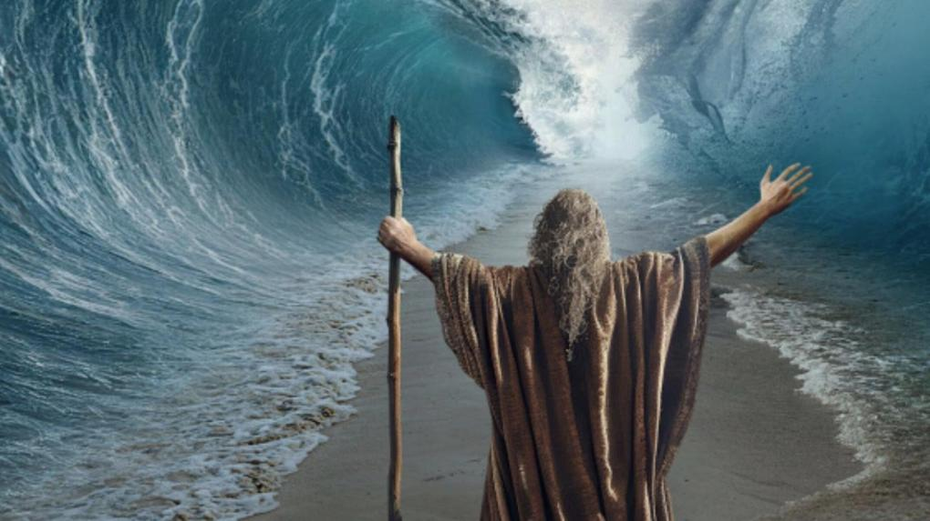
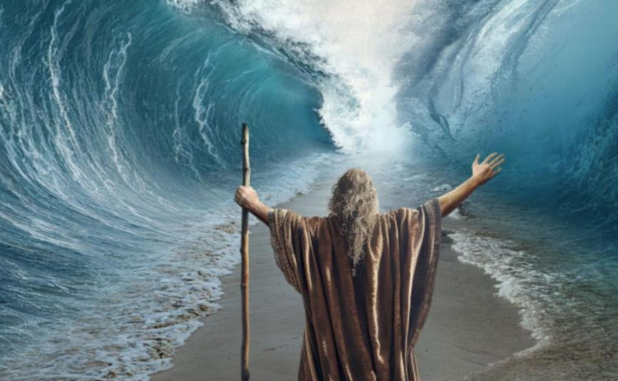
JEWISH HEROISM
A worldview beyond religion or origin.
A set of values that the Jewish people have upheld and preserved consistently throughout the generations.
Enduring traits that reveal themselves especially in times of hardship and crisis.
Unique in essence, not for the values alone, but for the distinctive way they are combined.
THE HEROISM OF OCTOBER 7th

Slide 6


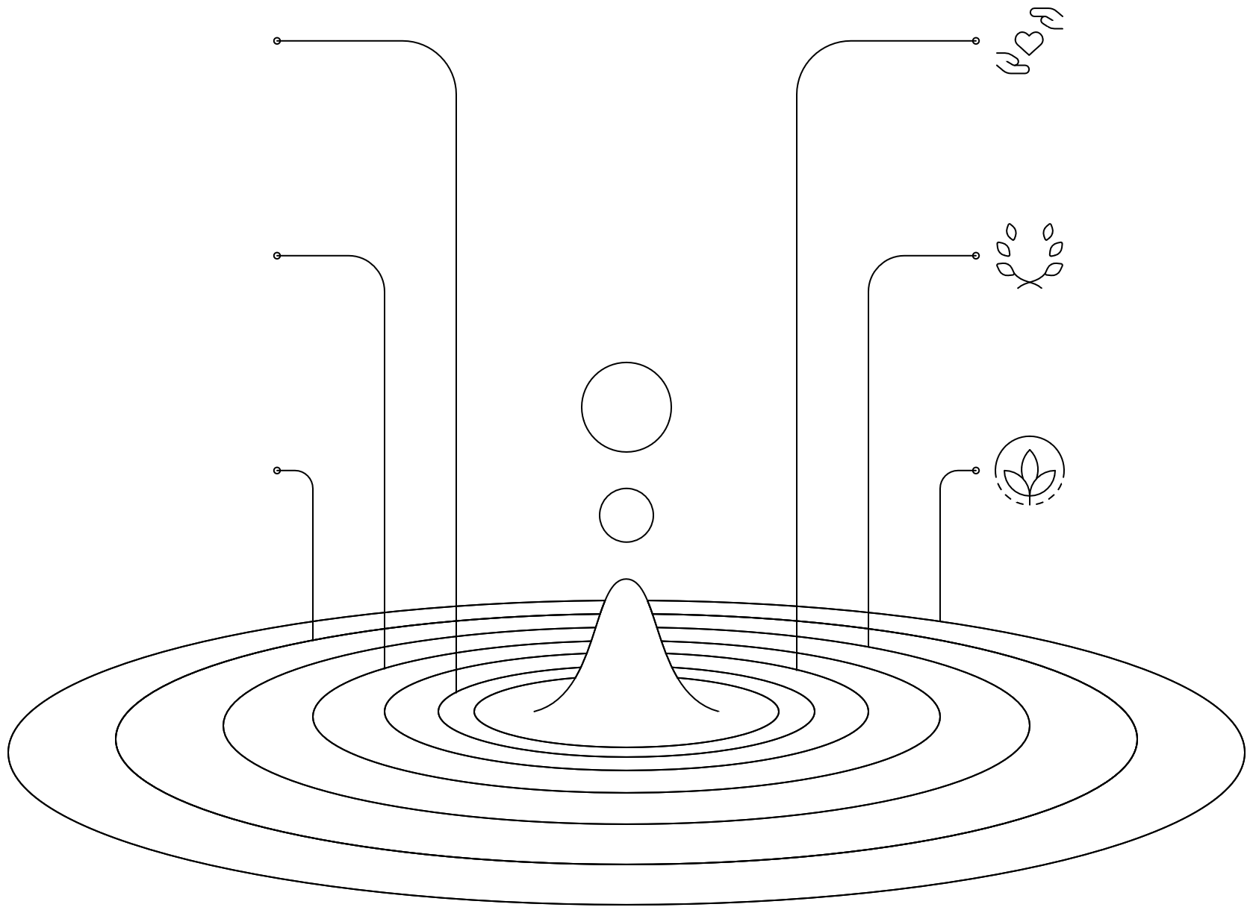

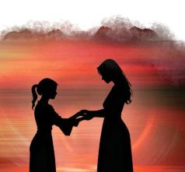
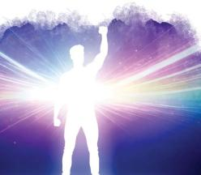
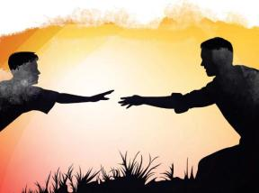
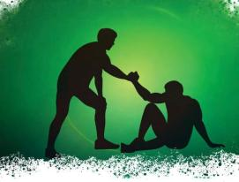
JEWISH HEROIC VALUES
A sense of responsibility and mutual commitment
Deep and enduring compassion
Refraining from violence and hatred
A desire to liberate and set others free
Modesty
Sanctity of life, not death
THE HEROISM OF OCTOBER 7th

Slide 7

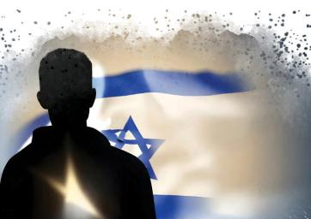
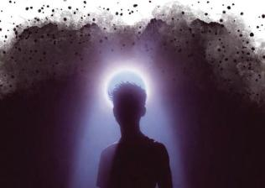
TRAITS OF JEWISH HEROISM
Growth and evolution from hardship
A creative response to challenge - turning trauma into a driving force for rebuilding, innovation, and original ways of coping.
Harmonious thinking for the greater good
Using knowledge and creativity to improve life for all - from Nobel Prize laureates to making the desert bloom.
Transcendent faith
Clinging to values even against impossible odds; believing in goodness and love to overcome every challenge.
Special spiritual resilience
Not only physical survival, but preserving identity, culture, and spirit even in the hardest times.
THE HEROISM OF OCTOBER 7th

Slide 8
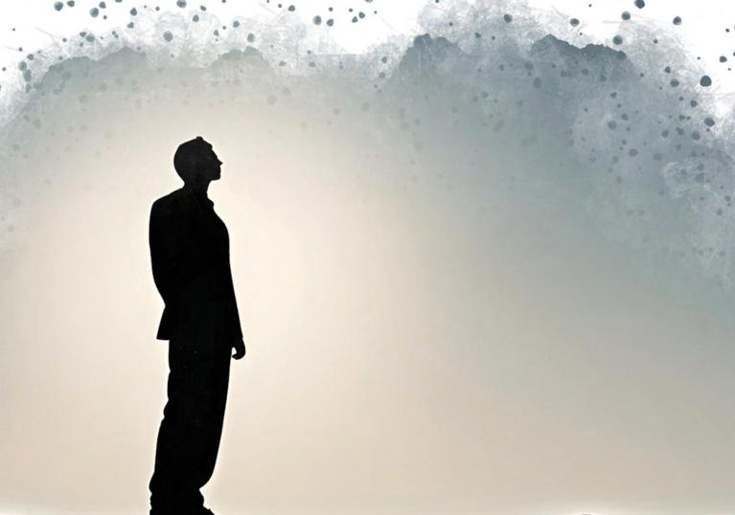
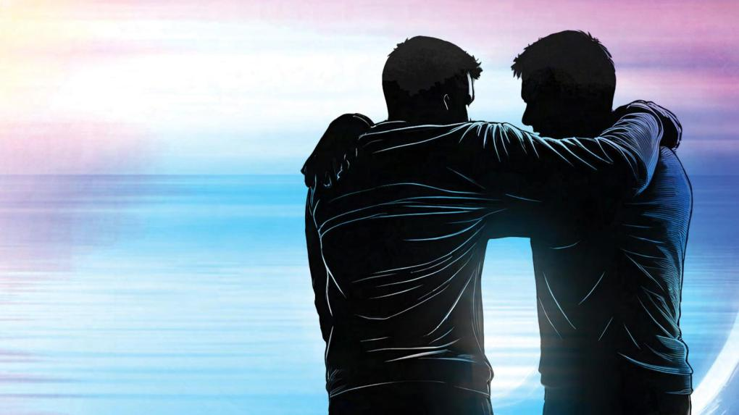
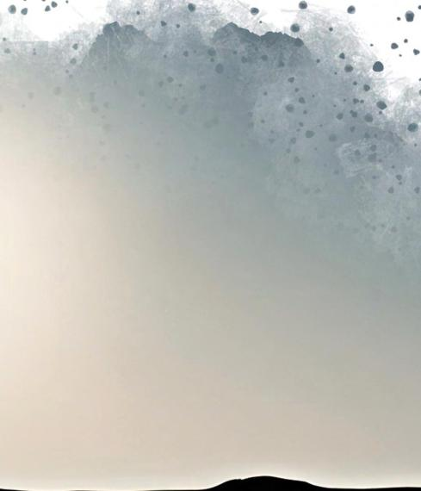
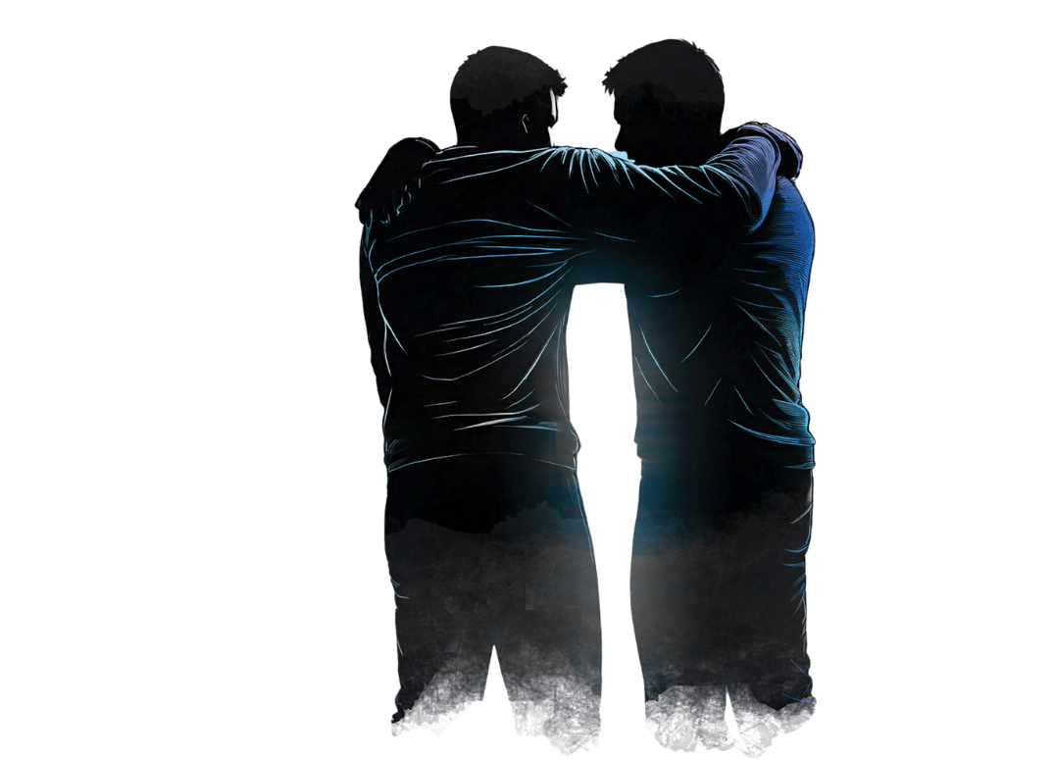
THE HEROES OF OCTOBER 7TH THROUGH THE LENS OF TIME
An immense number of heroes in a single day
Heroes whose acts embodied the values and traits of Jewish heroism
Heroes whose bravery connects to other Jewish heroes throughout the history of the Jewish people
Heroes who opened the door to a deeper understanding of the identity, values, and strength of the Jewish people.
AND HERE THEY ARE BEFORE YOU:
THE HEROISM OF OCTOBER 7th

Slide 9


THE ONE WHO STAYED
In Memory of Liron Barda
Liron worked at the Nova party and had many friends there. She could have escaped; her family begged her to.
Instead, she chose to stay and learned on the spot how to provide medical aid to people she didn’t know. The last time she was seen was with a wounded young woman who asked not to be left alone.
THE HEROISM OF OCTOBER 7th

Slide 10
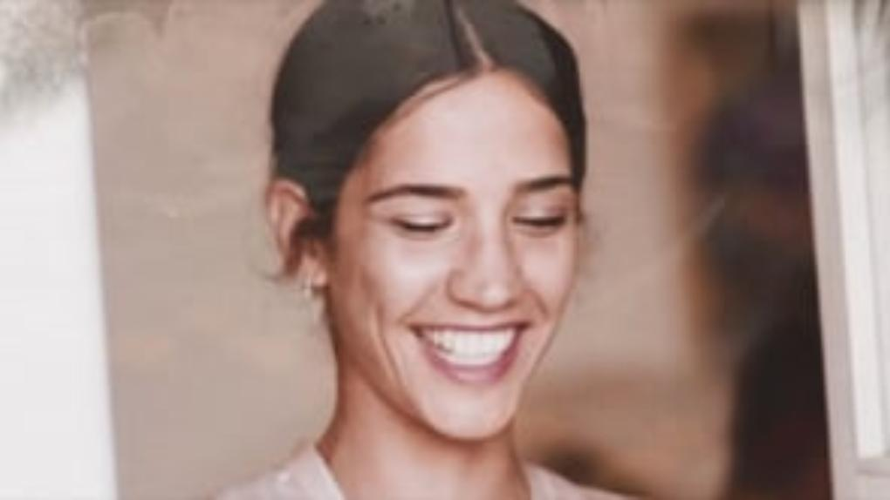

Slide 11
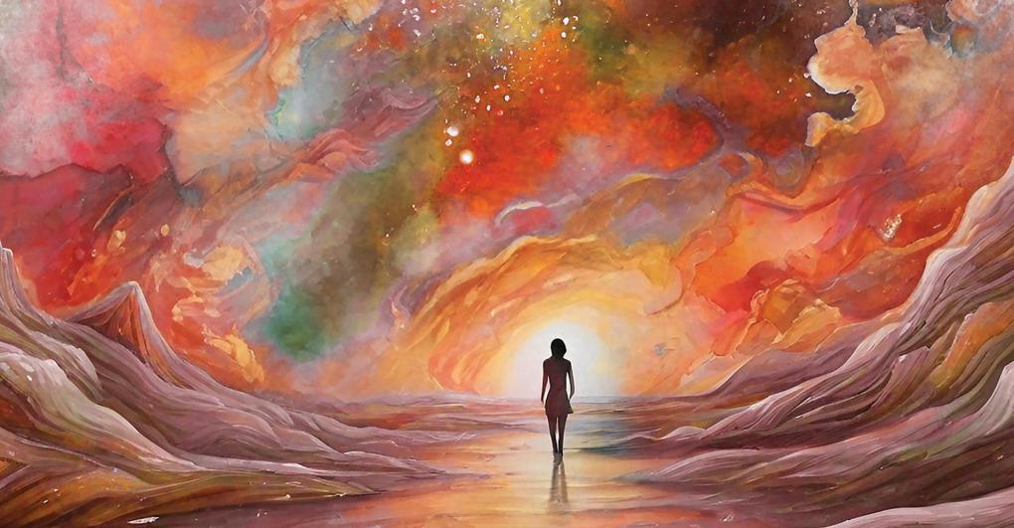
THE ONE WHO STAYED
In Memory of Liron Barda
Liron Barda is “the one who stayed,” embodying the principle of not abandoning a friend, true mutual responsibility with the cost of the ultimate price, her life.
THE HEROISM OF OCTOBER 7th

Slide 12

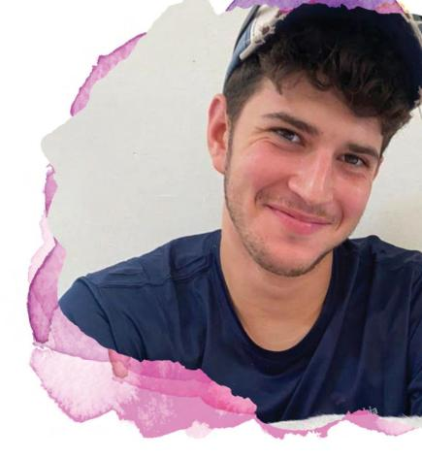
FOREVER INSIDE ME
In Memory of Netta Epstein
Netta and Irene lived together in Kibbutz Kfar Aza. They had planned to marry.
On the morning of October 7th, just a short time before the invasion of Hamas, Netta flew a kite towards Gaza as a symbol of peace. They were attacked in their home, and a grenade was thrown into their safe room. Netta jumped on it and sacrificed his life to save his beloved.
Irene, herself a true heroine, hid behind him and later told the story on which this song is based. She also invited the Heroes team to her home to film, and she is the one who appears in the video.
THE HEROISM OF OCTOBER 7th

Slide 13
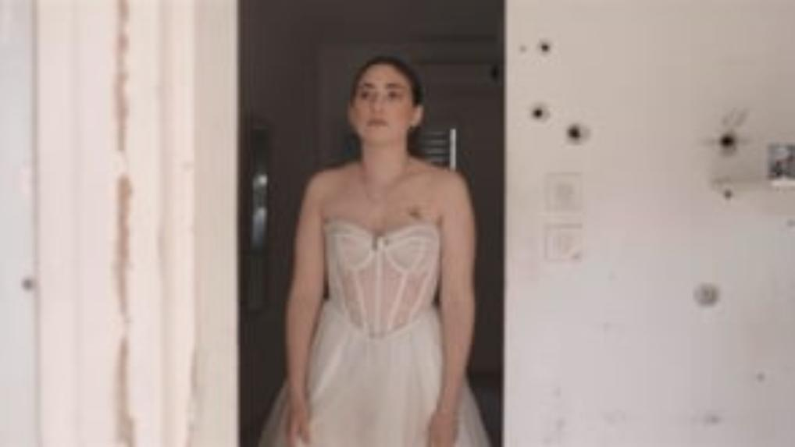

Slide 14

FOREVER INSIDE ME
In Memory of Netta Epstein
A story of true love, the kind of love that underpins heroism. The story of the Jewish people, above all, is a love story.
Our love for one another.
THE HEROISM OF OCTOBER 7th

Slide 15

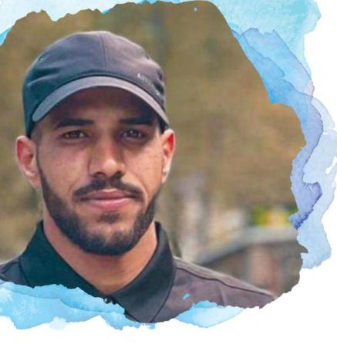
YOU ARE ISRAEL
In Memory of Amer Abu Sabila
Amer, a Muslim Bedouin, when passing through Sderot, saw what was happening and couldn’t remain indifferent. In a split-second decision, he jumped into a car to save the Swissa family, who were under terrorist fire.
When the father was murdered, Amer drove the mother to the police station, unaware that it had been taken over by terrorists. He and the mother, who were sitting in the front, were shot. While the two daughters were hidden in the back. When the police arrived at the vehicle, the six-year-old girl refused to open the door and asked the police officer, “Are you with Israel?”
Thanks to Aamer’s actions, the two daughters of the Swissa family were saved.
THE HEROISM OF OCTOBER 7th

Slide 16
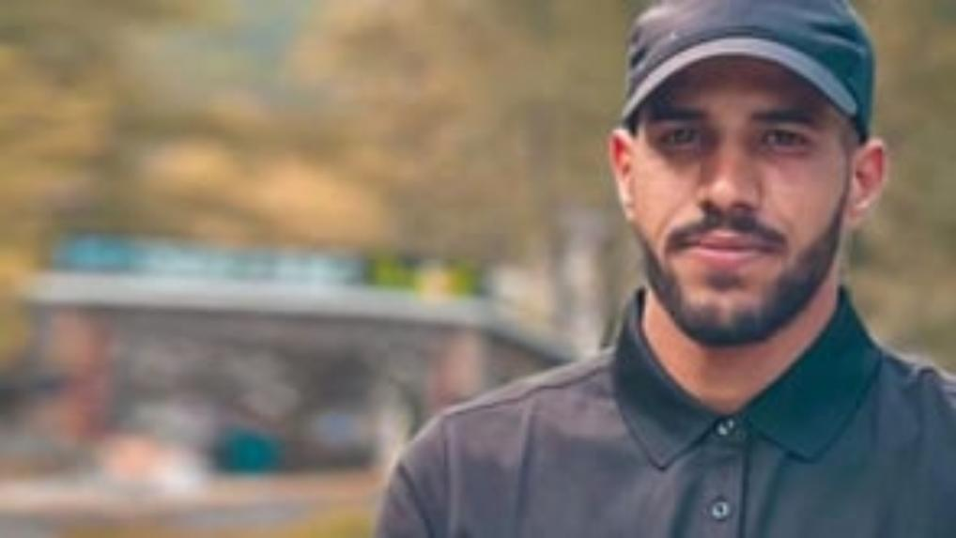

Slide 17
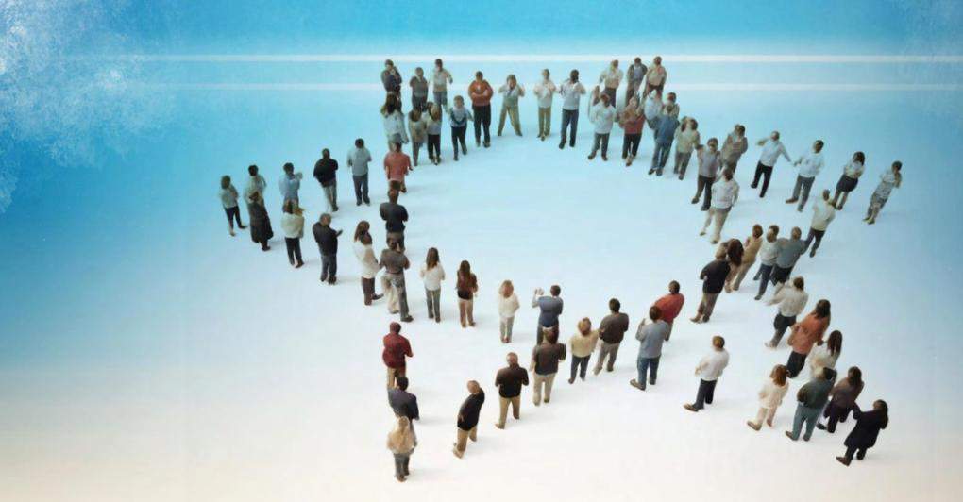
YOU ARE ISRAEL
In Memory of Amer Abu Sabila
If you are with Am Yisrael, you are Am Yisrael. If you are with us, you are one of us. Heroism is not a genetic or religious club; it is a worldview, a perception.
Amer, who left behind two children of his own so he could save two Jewish children, is our hero.
THE HEROISM OF OCTOBER 7th

Slide 18
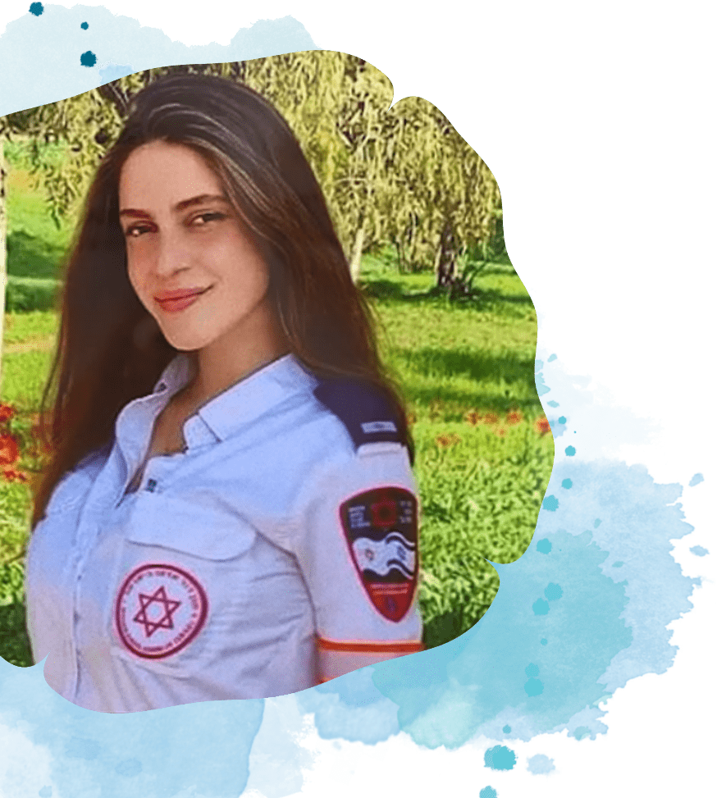





HELLO
In Memory of Amit Mann
A paramedic at Kibbutz Be’eri, Amit, went straight to the clinic when the Hamas attack started. For hours, she treated and tried to save severely wounded people while calling for help, until the clinic was breached.
People often say someone sings like an angel, in her case, it was literally true. Her sister, Haviva, told us that Amit’s biggest dream was to perform on stages around the world. Today, even though she is no longer with us, we were able to fulfill her dream, as she appears on the biggest stages in North America and the rest of the world, although she is on the other side.
THE HEROISM OF OCTOBER 7th

Slide 19
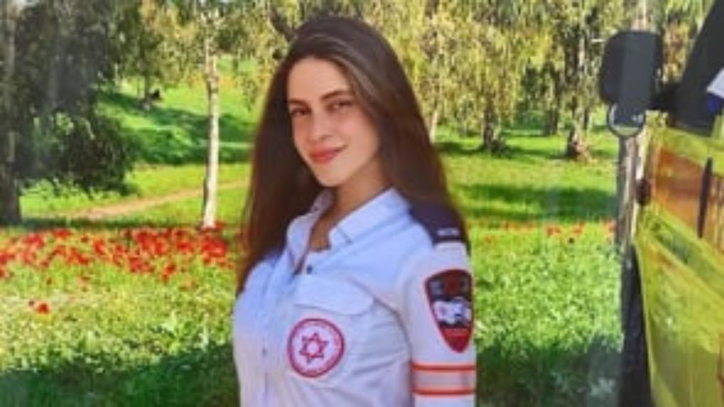

Slide 20

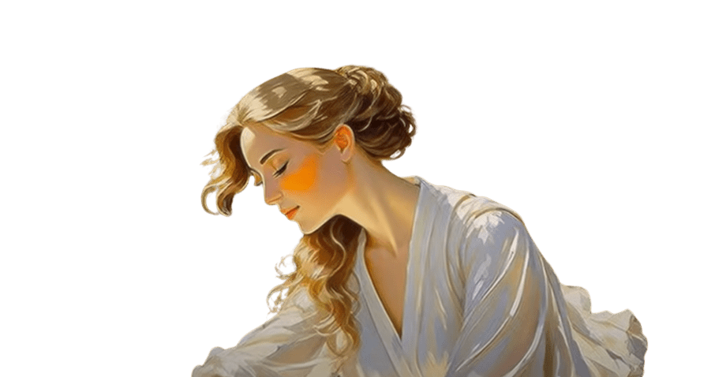
HELLO
In Memory of Amit Mann
The mutual responsibility Amit demonstrated, rushing straight to the clinic, treating the wounded under impossible conditions, and showing resourcefulness in calling for help, will resonate over time.
A young woman with dreams, who set them aside for the sake of others.
THE HEROISM OF OCTOBER 7th

Slide 21
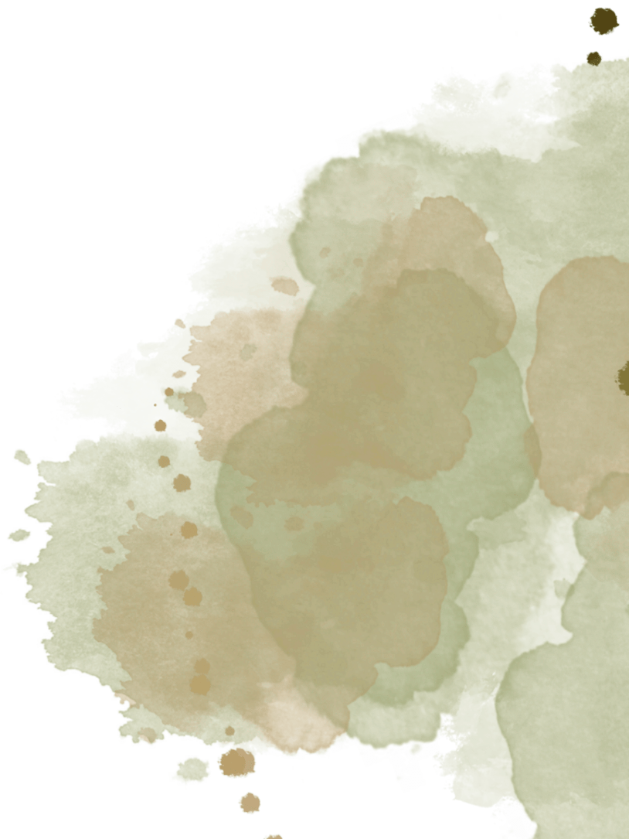


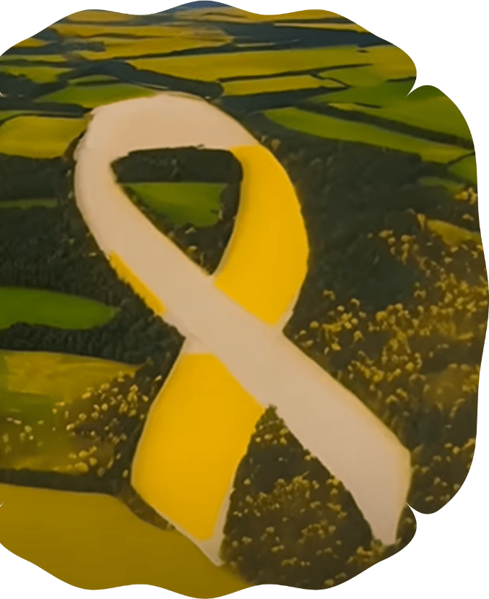
FREE
The Heroism of the Hostages
AMONG THE HOSTAGES, MANY STORIES OF HEROISM WERE ALSO REVEALED:
Yotam Haim was a musician- abducted from his home in Kfar Aza.
Despite the many difficulties he faced in life, which led some to believe he’d struggle terribly in captivity, not only did he survive, but he also overcame everything and managed to escape.
Eli Sharabi, who lost his wife and daughters, now strengthens those who try to support him.
Gadi Moses, whose first request after returning from captivity was to be driven to his destroyed kibbutz, Nir Oz, to rebuild it.
This song is dedicated to all the families of the hostages.
THE HEROISM OF OCTOBER 7th

Slide 22
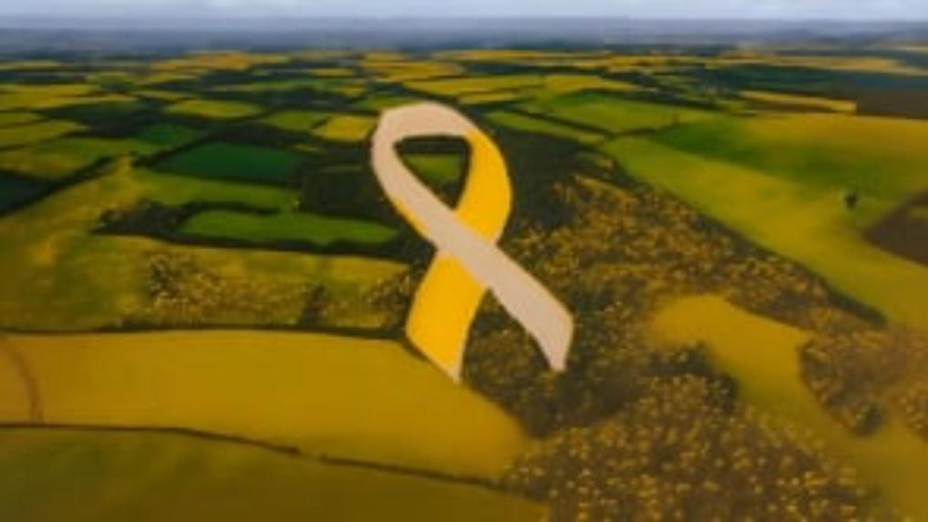

Slide 23

FREE
The Heroism of the Hostages
The fact that so many hostages demonstrated acts of heroism during captivity proves that even if a human being is deprived of liberty and subjected to torture of body and soul, there still remains a certain degree of freedom of choice that cannot be taken away.
This inner freedom is what allows a person to act according to personal values, especially under the harshest conditions. Choosing heroism, in this sense, may be the ultimate act of freedom.
THE HEROISM OF OCTOBER 7th

Slide 24

HIGHLIGHTS
Heroism is an act that never ends
Every act of heroism becomes a light that never fades, continuing to heal and inspire even years into the future.
The moment we share a heroic story, we become part of it. By echoing heroism, we not only honor the past but also strengthen life in the present and offer hope for the future.
The Uniqueness of Jewish Heroism
Stories of heroism exist in every nation, but in Judaism it is a consistent and unique value that has become a universal symbol, always representing the very best of humanity.
Jewish heroism transcends boundaries of religion or biology - it is a worldview, a set of values that the Jewish people have carried faithfully throughout history, and fulfilled time and again, even in the most difficult moments of trial.
THE HEROISM OF OCTOBER 7th

Slide 25

TAKING PART IN RESHAPING THE STORY
Share the stories of heroism:
Even if we did not perform the act of heroism ourselves, we can take part in it by echoing a story of heroism. By doing that we become part of it and continue its impact. An act of heroism does not end as long as we continue to echo it.
Let the stories speak:
Prefer echoing the light over debating opposing narratives. The stories of heroism already hold everything - values, inspiration. All you need to do is share them. Irrational problems, such as antisemitism, will not be solved rationally, but rather in a non-rational way - by increasing the light. Just as logic solves a problem of logic, in this case, emotion can replace emotion.
Find your unique way
to pass on the light:
The more we pass the light forward, the more it will grow and strengthen us and the generations to come. Share the stories of heroism in a way that is closest to your heart - write a song, paint a picture, create a video about a hero, or express it in any other creative way you choose.
Be the first to change history:
History is built and is being repeated according to the story that is told. We must choose to tell our story as heroes. For the first time in Jewish history, we will tell it from a different angle, one of heroism. First to ourselves, and then to the world.
THE HEROISM OF OCTOBER 7th

Slide 26



Join Project Heroes
THE HEROISM OF OCTOBER 7th

Slide 27

MORE HEROES
THE HEROISM OF OCTOBER 7th

Slide 28

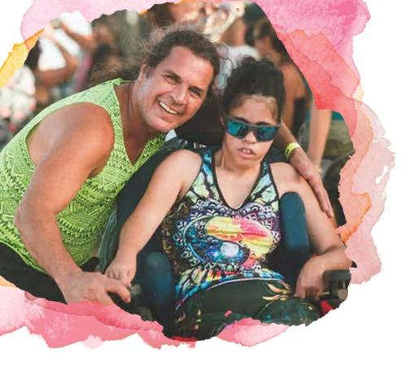
ANGELS
In Memory of Erick and Ruth Peretz
Though Ruth had cerebral palsy and muscular dystrophy, she loved going to parties. Erick, her father, would take her to music festivals all around the world.
On the dance floors they shared, they would dance together, often in an embrace, sometimes with Ruth’s wheelchair glowing in colorful lights.
At the Nova festival, they were found in each other’s arms.
THE HEROISM OF OCTOBER 7th

Slide 29


Slide 30
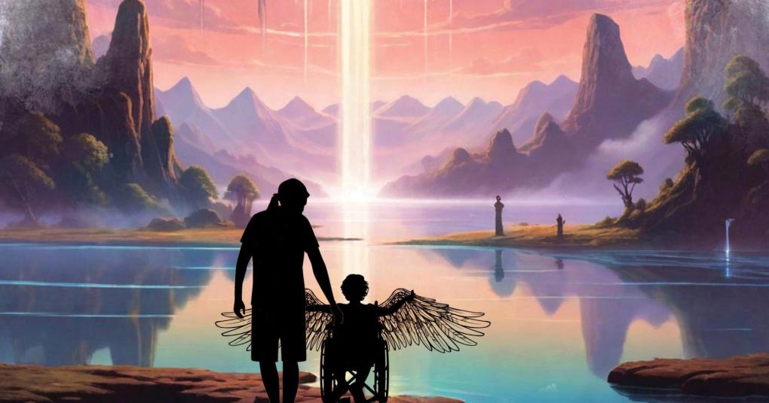
ANGELS
In Memory of Erick and Ruth Peretz
Throughout her life, Erick cared for Ruth with extraordinary devotion, never allowing difficulties to deprive her of many happy moments.
Erick used to say: Ruth is a treasure, the whole world is family, we need unity and love, we need to enjoy life.
THE HEROISM OF OCTOBER 7th

Slide 31
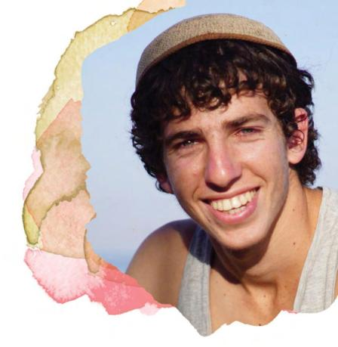
WITH BARE HANDS
In Memory of Yonatan Elazari
Yonatan was a very adventurous boy, his mother always said she lived with constant worry. On October 7th, he was visiting friends and slept in Ofakim.
When armed terrorists arrived, even though he was in a protected place and unarmed, he went out with his bare hands to fight them.
He felt it was his moment. He raised a stone, like King David, to fight the armed terrorists. Later, he got hold of weapons, fought all day, and saved many lives through his actions.
THE HEROISM OF OCTOBER 7th

Slide 32
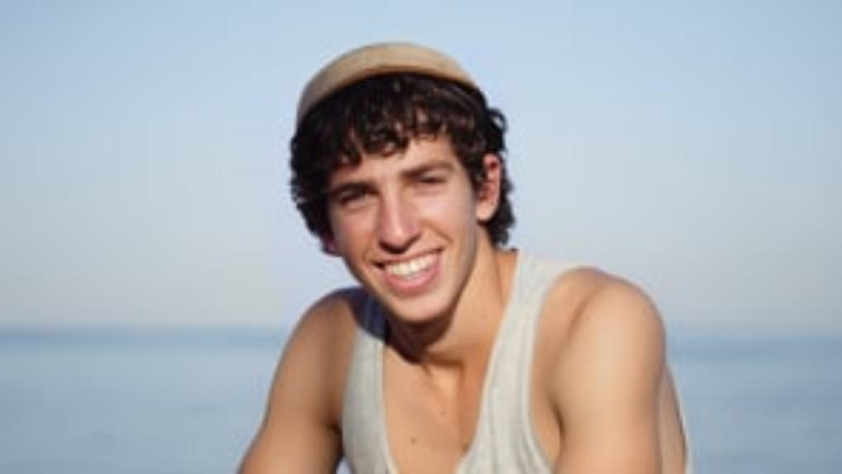

Slide 33
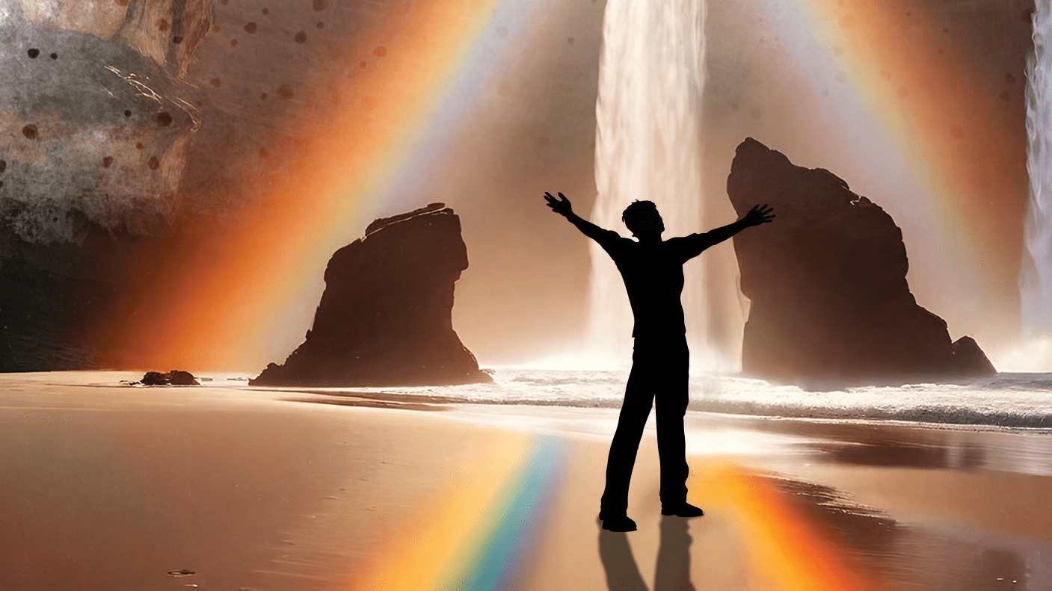
WITH BARE HANDS
In Memory of Yonatan Elazari
WE SPEAK of the Bible as a book that has already been written and finalized, but we continue writing its verses every day through our actions.
Yonatan Elazari, who fought under impossible conditions, just like the Jewish people in every generation, is a biblical hero of our time.
The heroes of the Bible are all around us. History is being written in every moment.
THE HEROISM OF OCTOBER 7th

Slide 34

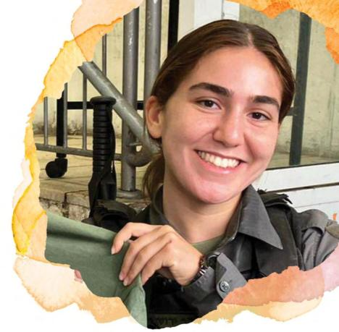
LONE SOLDIER
In Memory of Rose Lubin
Since she was a child, Rose knew she wanted to defend Israel. She was a wonderful daughter and sister, grew to be a magnificent singer, and decided to make Aliyah from the US to protect Israel.
At age five, a girl in kindergarten wanted to be her friend, and she replied: “I’d love to be friends, just know that when I turn 18, I’ll move to Israel to join the IDF.”
She demonstrated great heroism on October 7th and became a symbol of the amazing phenomenon known as the Lone Soldier.
THE HEROISM OF OCTOBER 7th

Slide 35
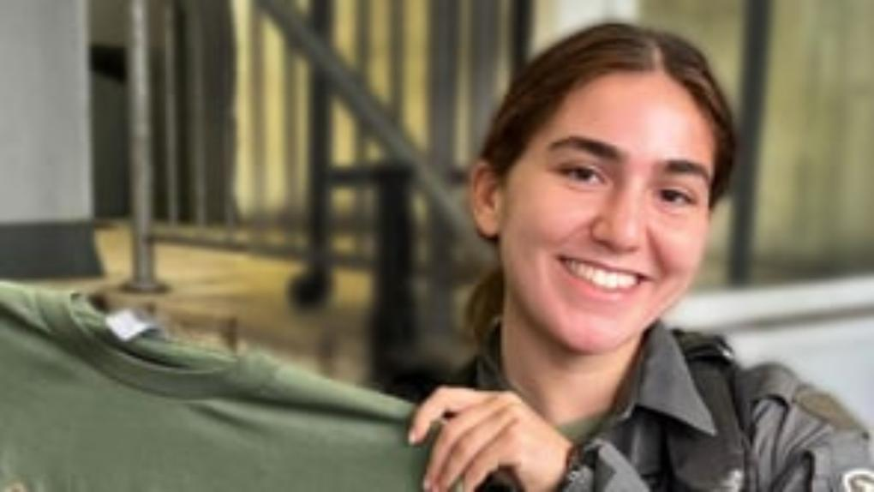

Slide 36
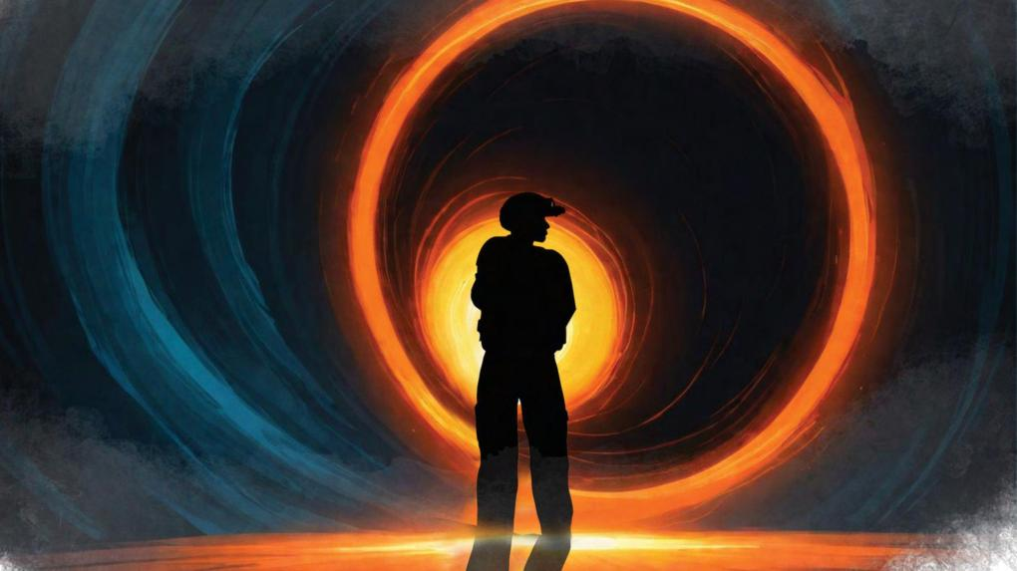
LONE SOLDIER
In Memory of Rose Lubin
What causes someone to leave their life behind and fly across the world, to risk it all? What does it say about our people, who remained united despite historical dispersion? What do these invisible connections between us mean?
Lone soldiers show that our fight is not for land, it is for each other.
THE HEROISM OF OCTOBER 7th

Slide 37

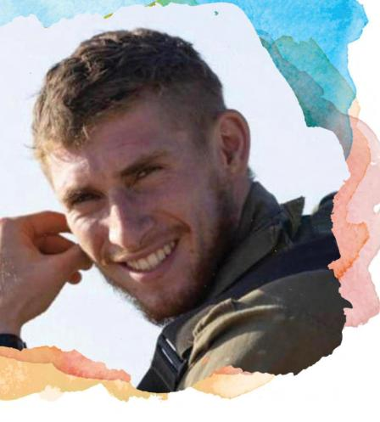
THE HERO CHILD
In Memory of Aner Shapira
At the party, within moments, he found himself trapped with 30 people in a shelter.
When grenades were thrown in, Aner heroically caught them with his bare hands and threw them back at the terrorists eight times, saving the lives of the ones behind him.
But it’s not only what he did, it’s what he said:
“I’m Aner. The army is on its way. I’ll protect you. If something happens to me, keep doing what I’m doing.” He didn’t just save them physically, he protected their souls.
THE HEROISM OF OCTOBER 7th

Slide 38
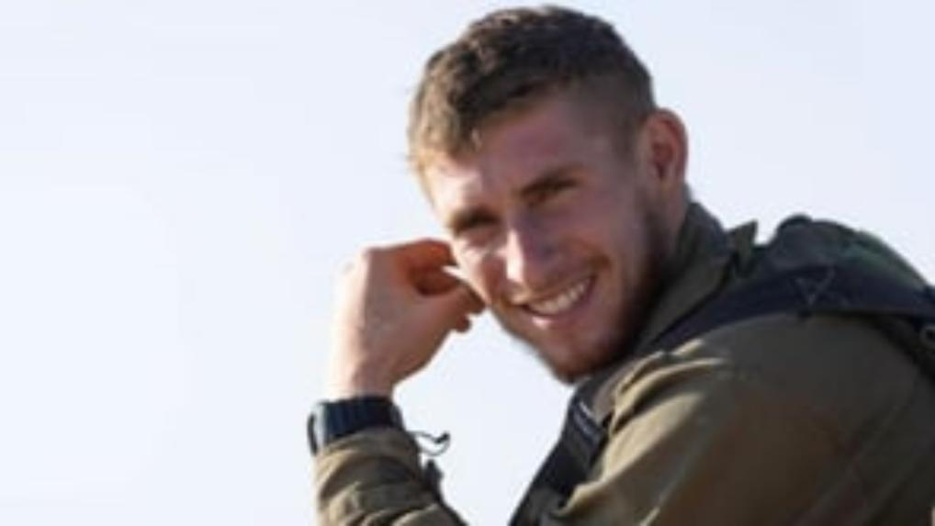

Slide 39

THE HERO CHILD
In Memory of Aner Shapira
WE are a people who raise our children to be both warriors and artists. We fight for a better world that we are creating, and that is our people. Aner was a musician, a painter, and a protector warrior. A symbol of love and music, of mighty fighters - a very special combination.
It turns out our children are so much more than we imagined them to be. They called them the “TikTok generation” with scorn. But today’s youth, the students, you are our heroes.
THE HEROISM OF OCTOBER 7th

Slide 40

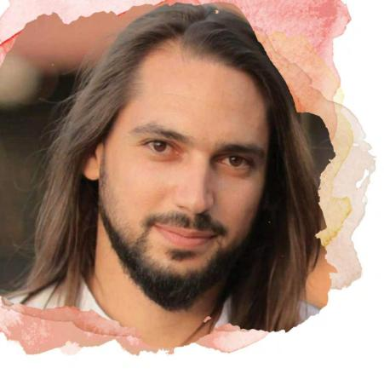
WHO IS THE MAN?
In Memory of Ben Shimoni
Even after managing to escape from Nova while saving others,
Ben decided to return to the terror scene, to hell, to save others.
And after doing so, he kept going back, eventually saving 13 people.
THE HEROISM OF OCTOBER 7th

Slide 41
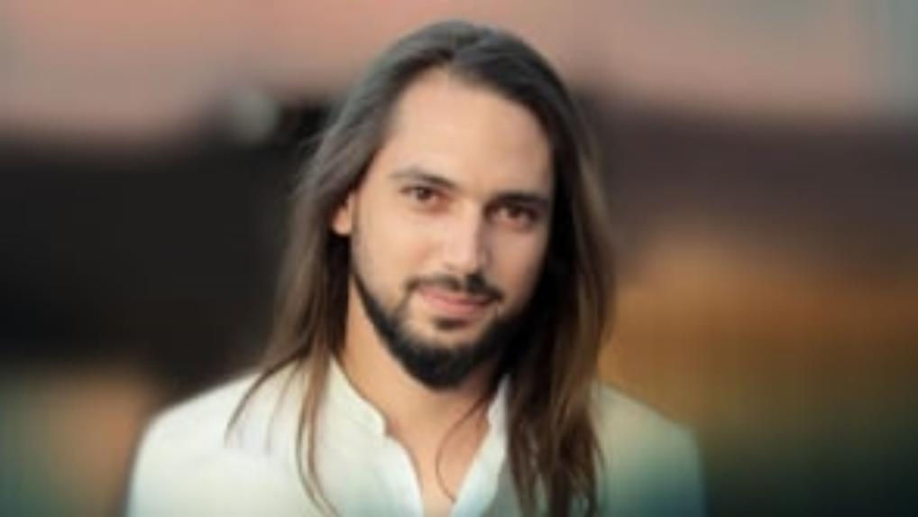

Slide 42
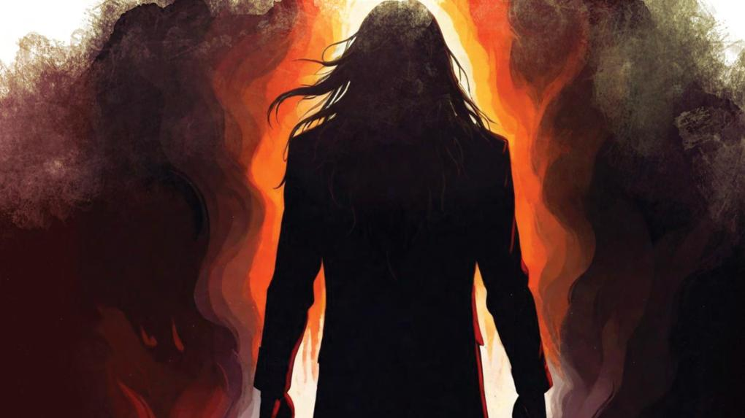
WHO IS THE MAN?
In Memory of Ben Shimoni
Who is the man who chooses to do that? Against instinct, despite his family’s wishes. Who is the man who, after escaping hell, chooses to return again and again to save others?
Ben was a guy who went out to party and ended up one of the greatest heroes in Israel’s history.
THE HEROISM OF OCTOBER 7th

Slide 43


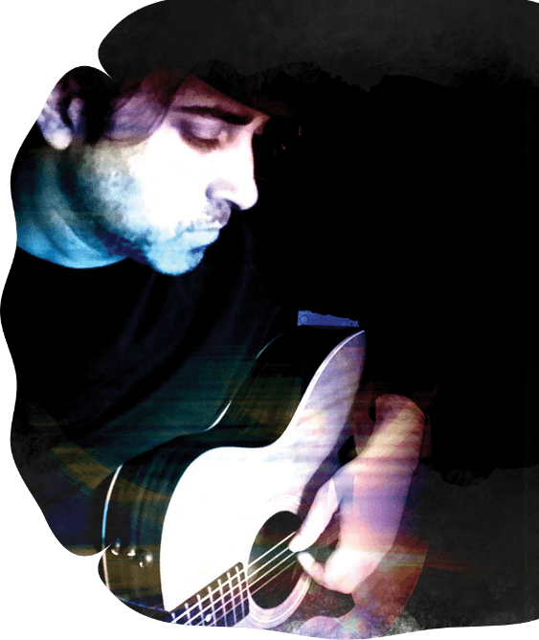
ACHSHAV TOV (IT’S GOOD NOW)
This song is the personal story of the founder of Project Heroes, Gilad Segev, about his personal hero - his brother, Sharon Segev, who was killed during his service in the IDF.
The song was written about a fun day they shared when Gilad was a child recovering from surgery and couldn’t participate in sports activity day at school: Sharon, his brother, heard about it, and came back from the army especially to give him the best day ever.
This is a song Gilad wrote for himself, standing at a crossroads of despair. Choosing to see the good, he chose to name the song “it is good now” and not “it will be good”. We all stand at a crossroads after October 7th and its horrors, where we need to make a decision, and choose to focus on sharing the good.
THE HEROISM OF OCTOBER 7th

Slide 44
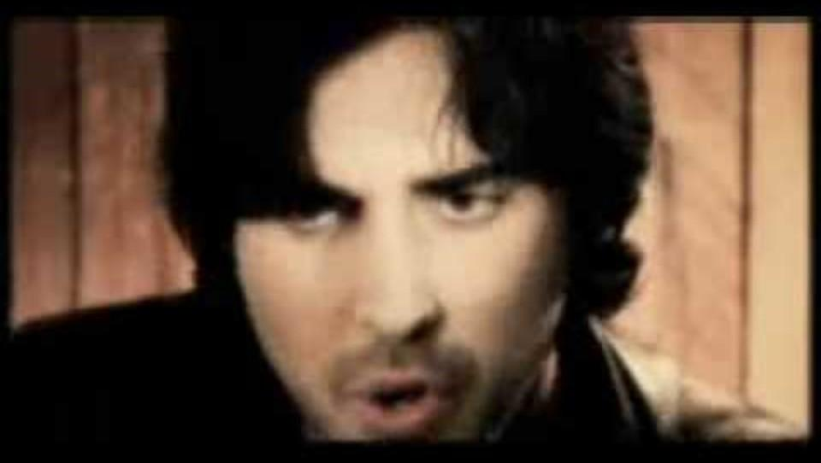

Slide 45
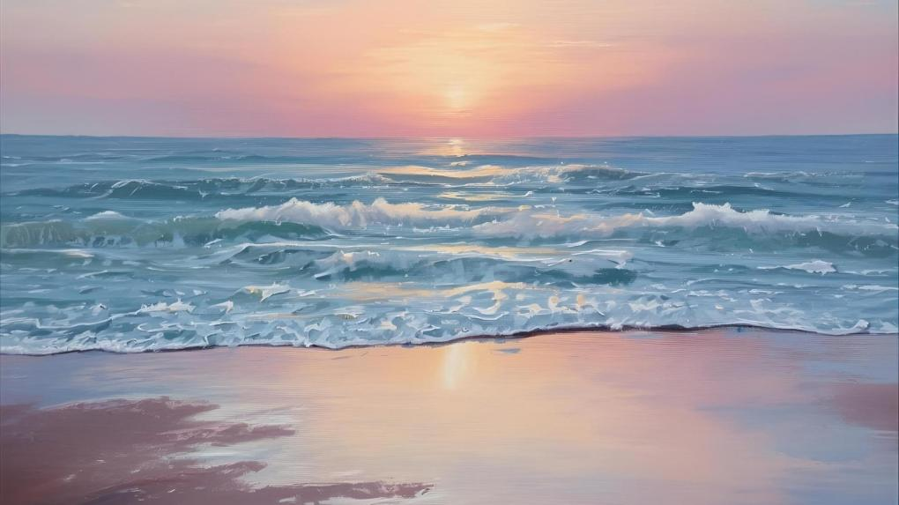
ACHSHAV TOV
(IT’S GOOD NOW)
Like Gilad, we too are at a crossroads, and we must choose well.
We can fall into trauma and remain there, but we must choose to see things through the lens of heroism and hope.
Everything depends on how we tell the story, through heroism, not victimhood, and that’s the essence of Project Heroes.
THE HEROISM OF OCTOBER 7th

